Slide 1


Slide 2
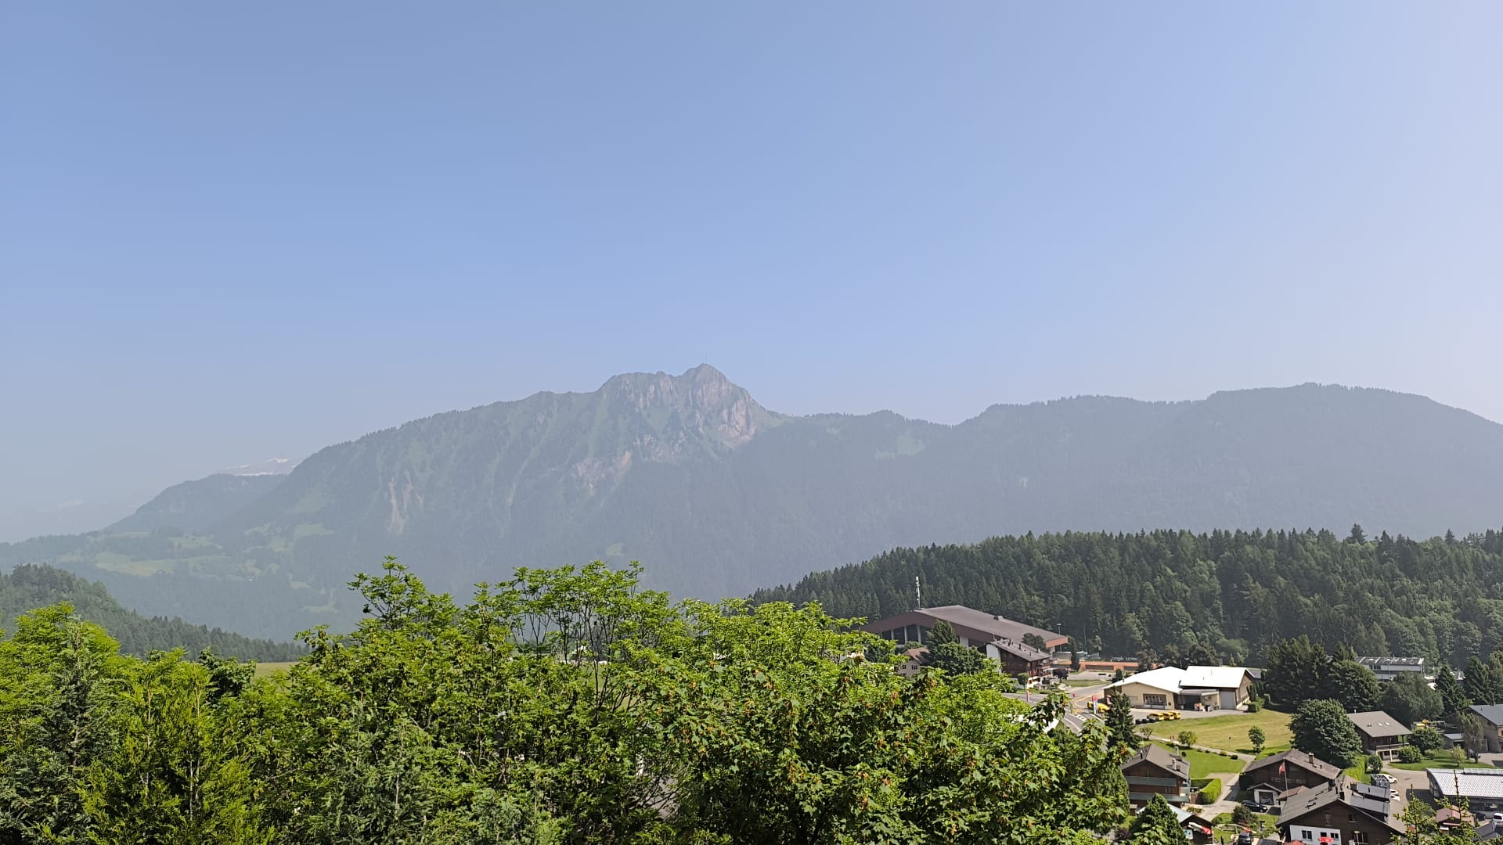
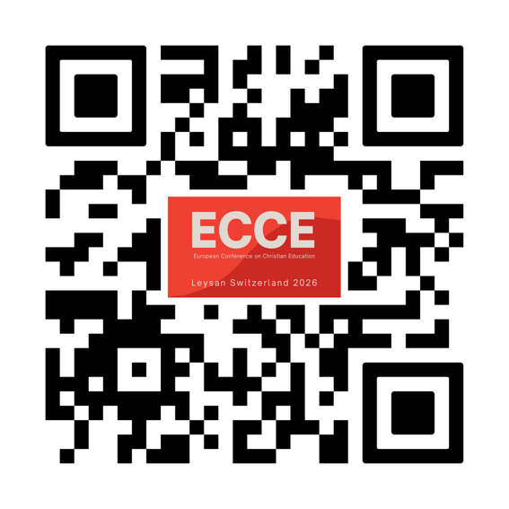
Register now!
ECCE conference is for all who work in children ́s ministry and/or coordinate this work in the Church.

Slide 3
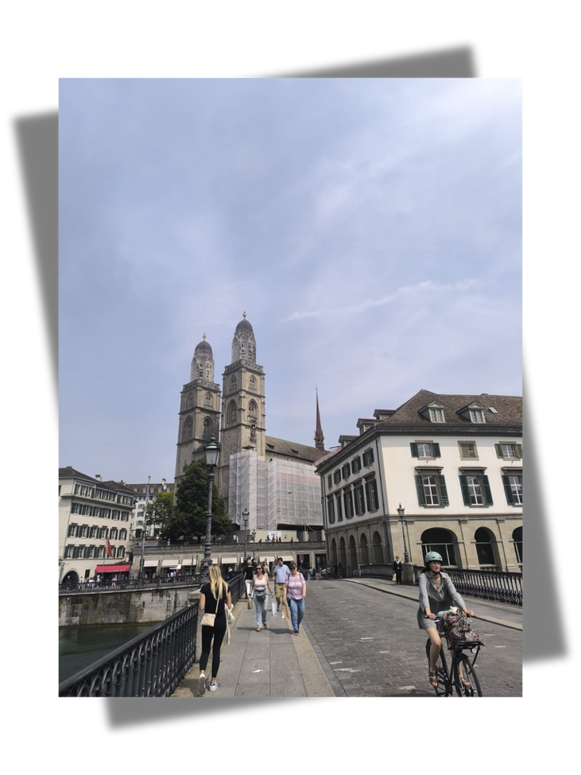
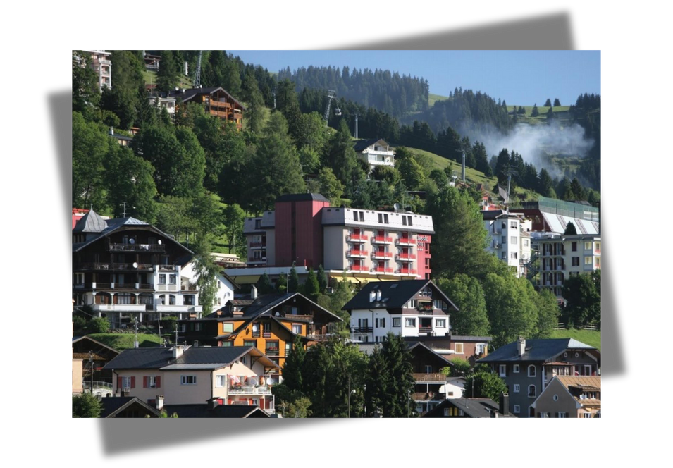
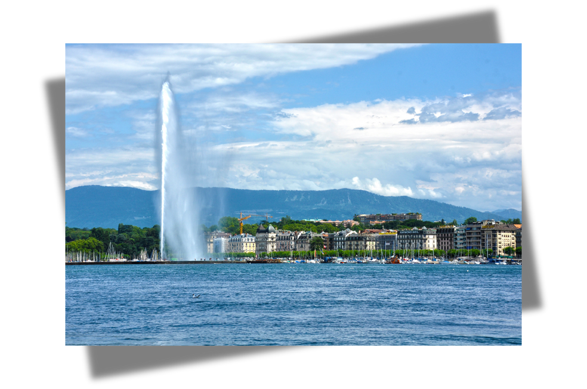
Zurich
Arrival 8th june
- Zurich (gathering event)
Conference
- Leysin, Canton de Vand
Departure 12th June
- Geneva (closing event)
Leysin
Geneva

Slide 4

ECCE is a three-yearly conference
Participants are responsible for their own travel costs to Zurich and from Geneva.
All transfers between Zurich - Leysin - Geneva are included.
Many thanks for grant funding from
the Reformed Evangelical Church of Switzerland to make the conference possible.
Financial support may be available in special circumstances.

Slide 5
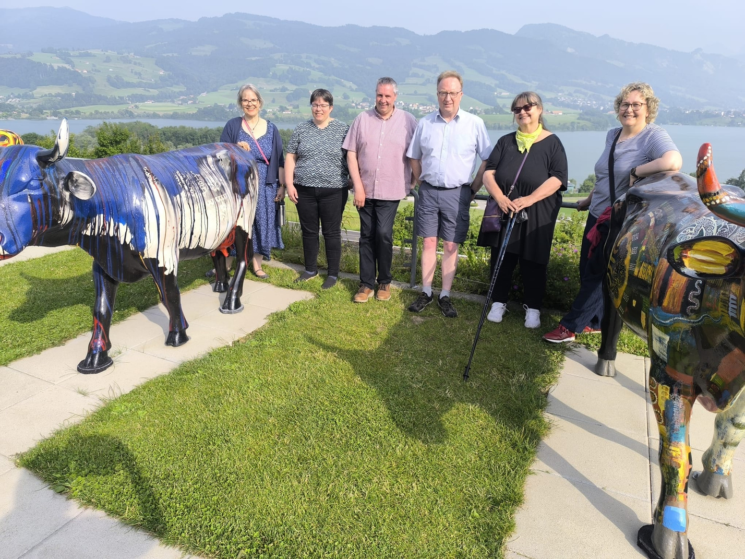
ECCE steering group in Guyere
Nicole Awais (Latin Region and presidence)
nicole.awais@ref-fr.ch
Katalin Vincze (Eastern Region) katalin.vincze@lutheran.hu
Aled Davies (the Treasurer)
aled@ysgolsul.com
Peter Hamill (UK Region) edunorth@rcbcoi.org
Anita Ahtiainen (Nordic Region), anita.ahtiainen@lnk.fi
Susanne Haeβler in photo but now Eva Forssman (Central Region) eva.forssman@elkd.de

Slide 6
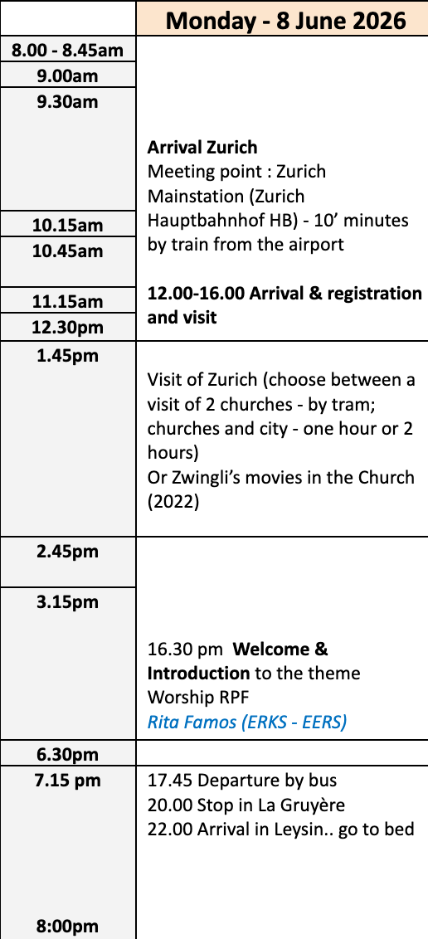
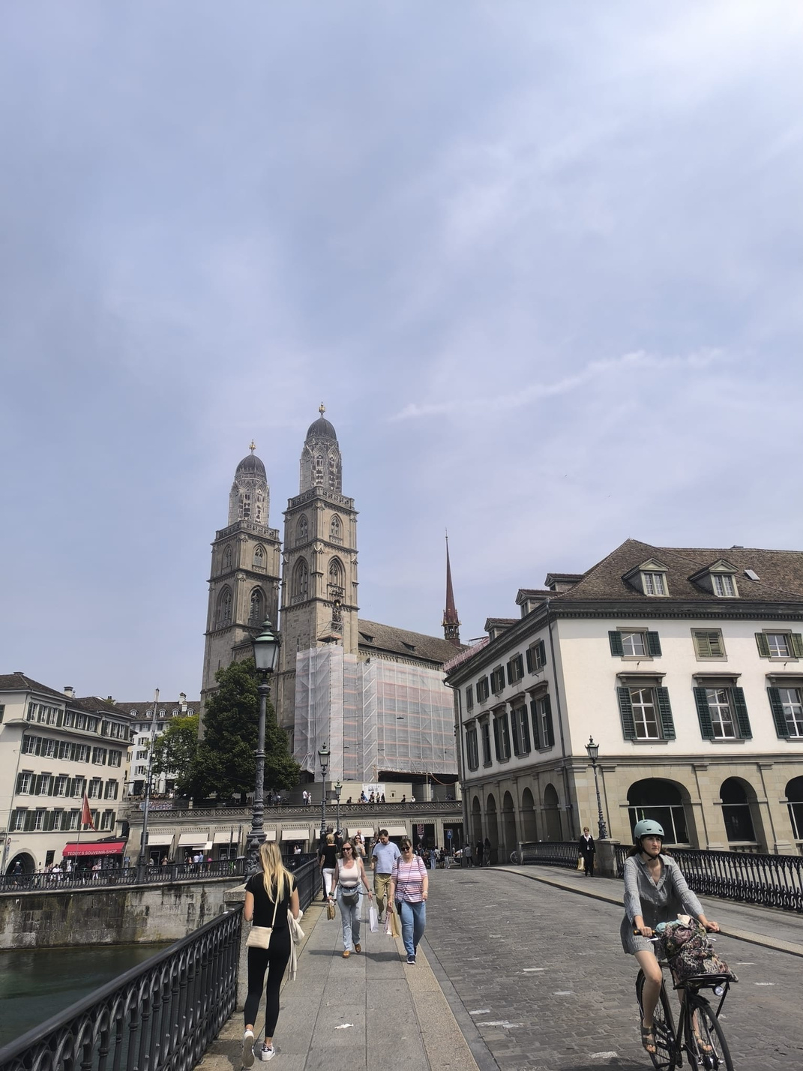

Slide 7
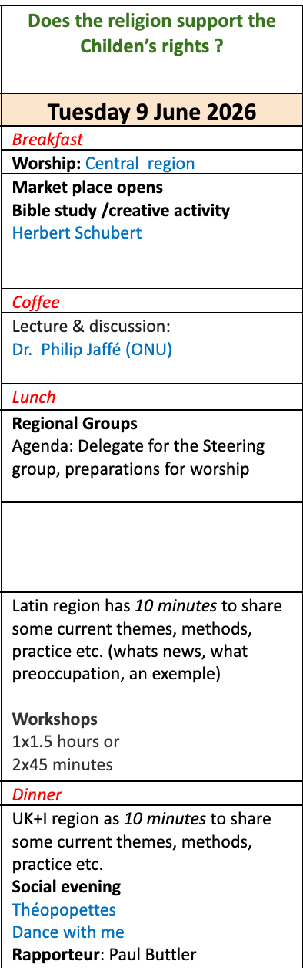
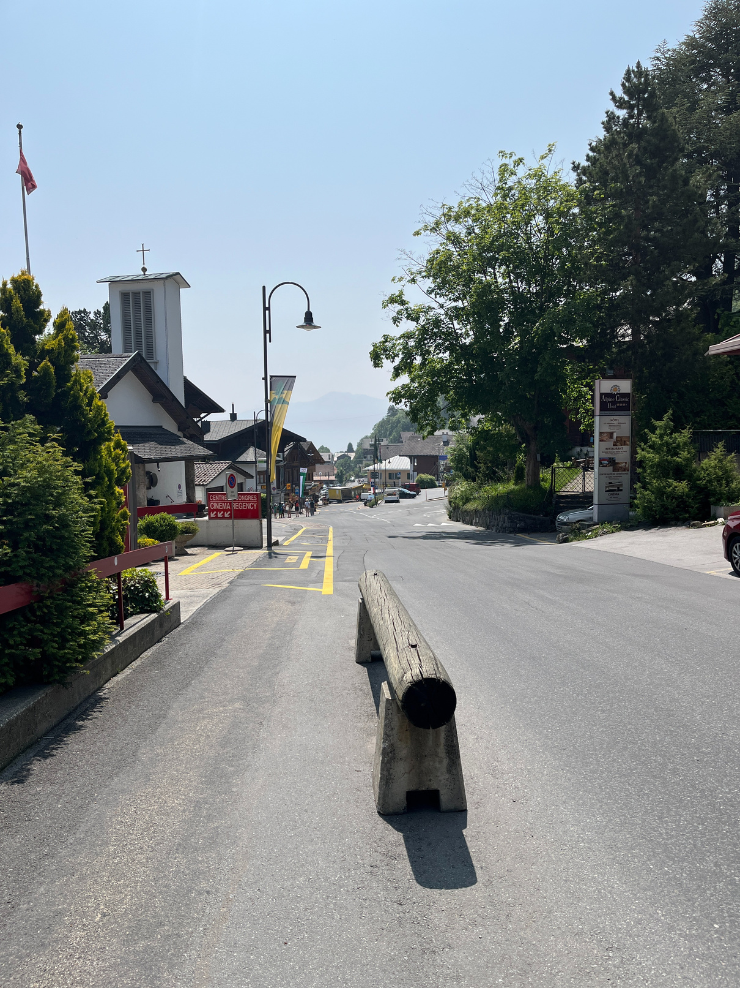

Slide 8
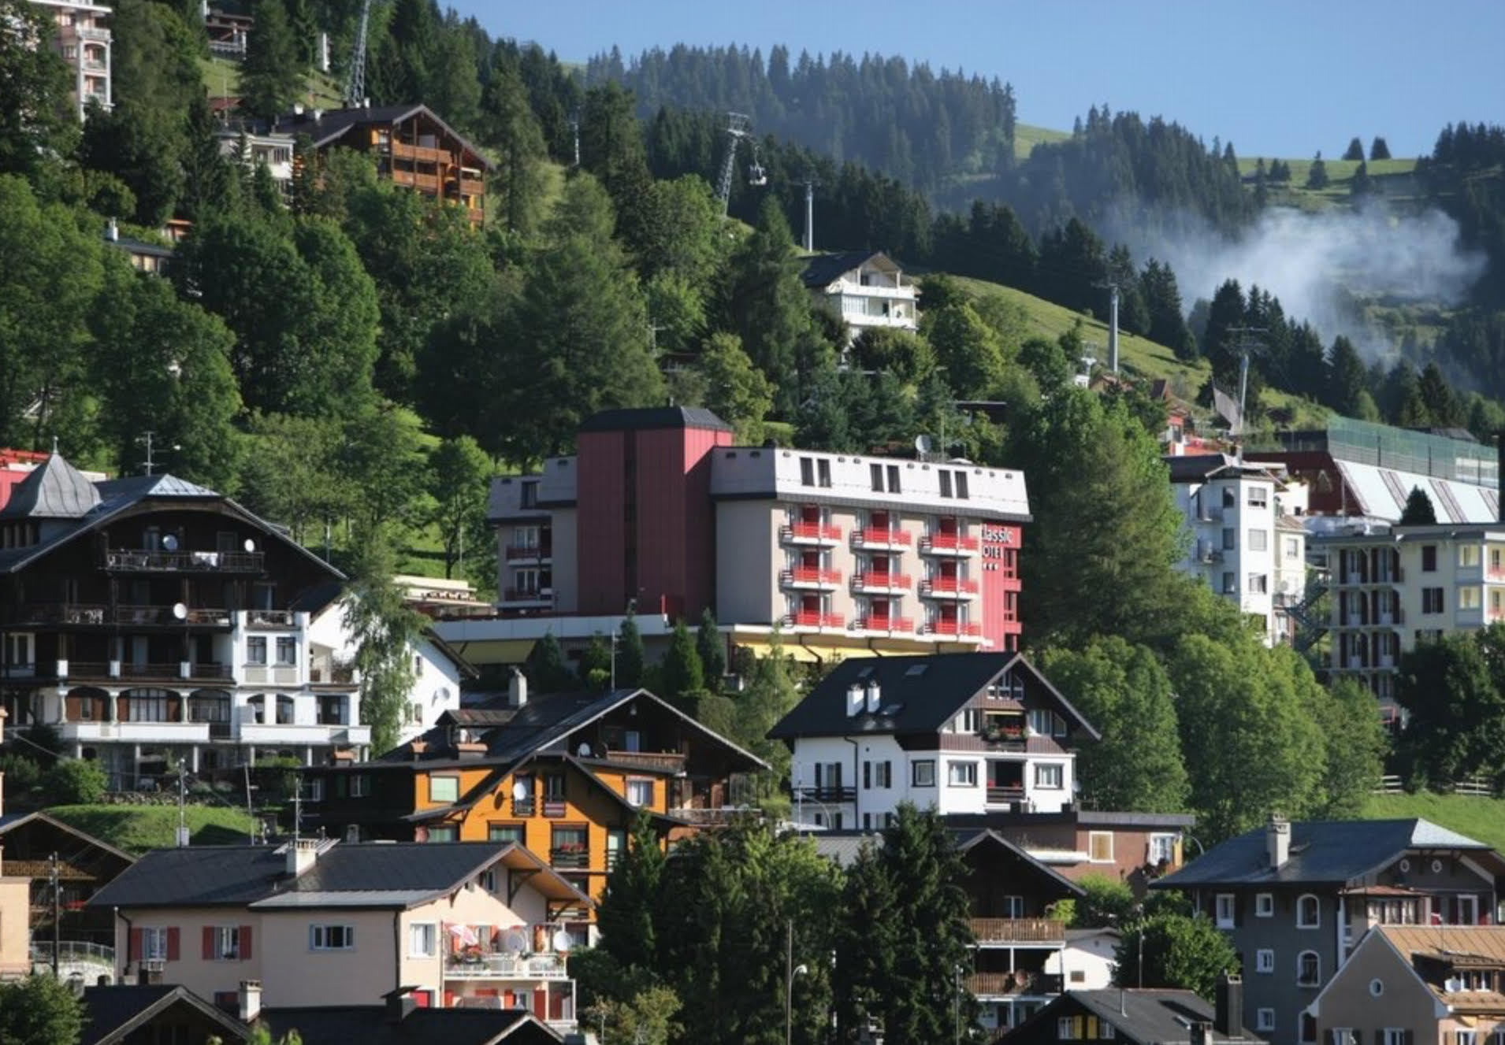
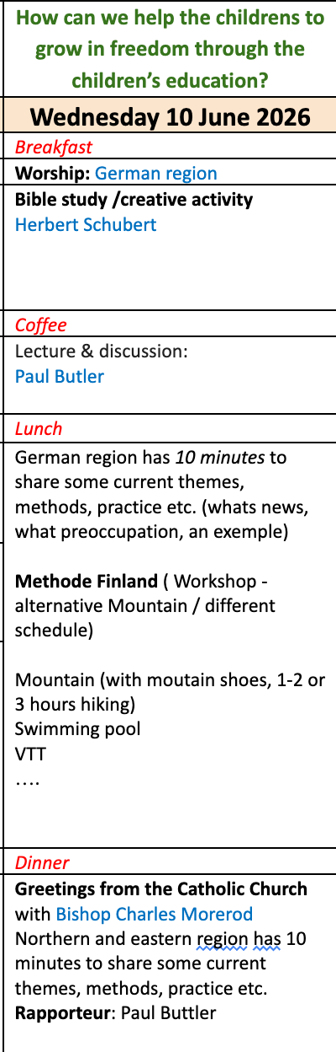

Slide 9
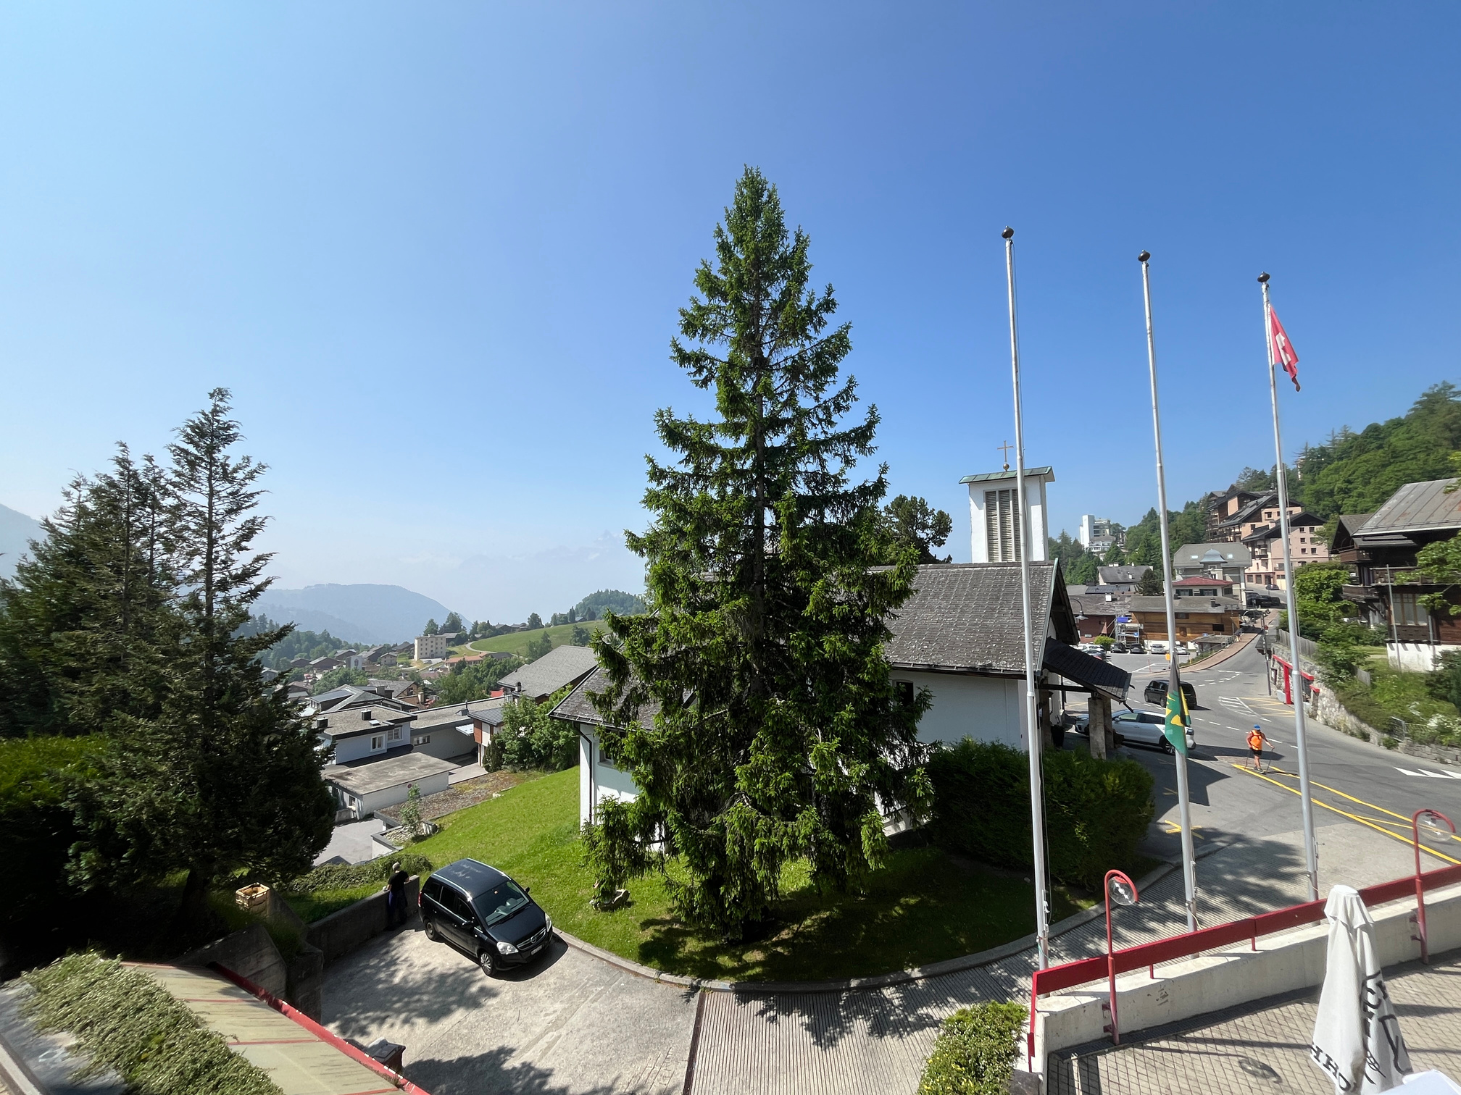


Slide 10
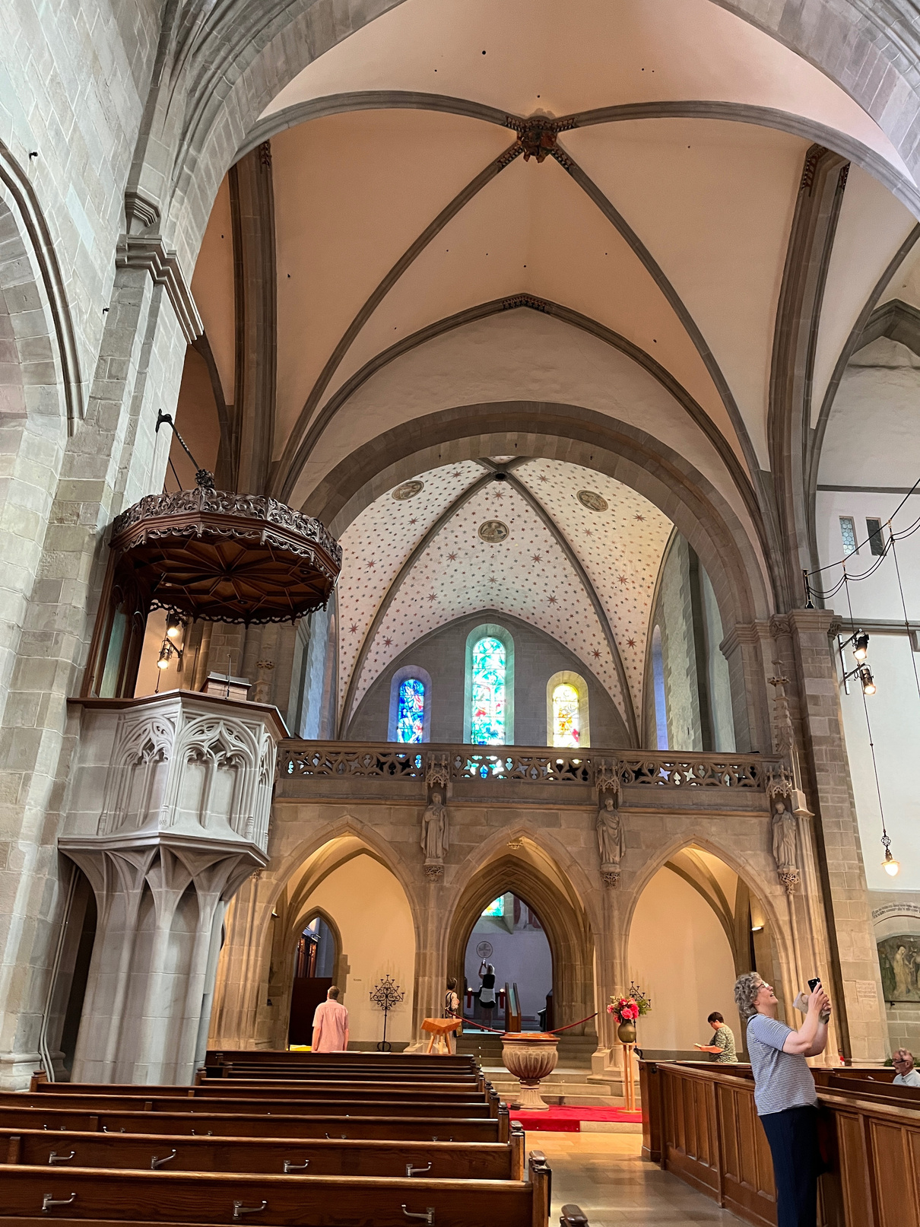
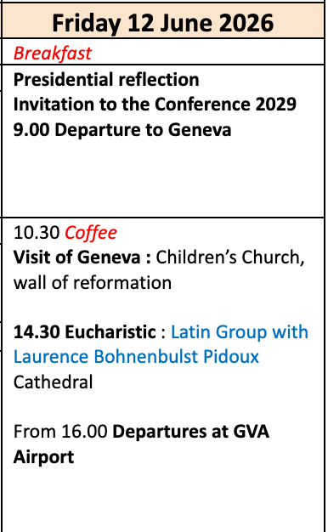

Slide 11
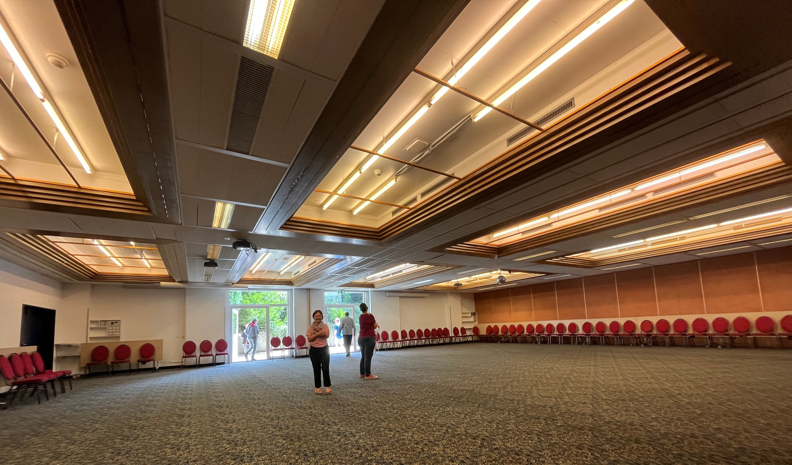

Slide 12
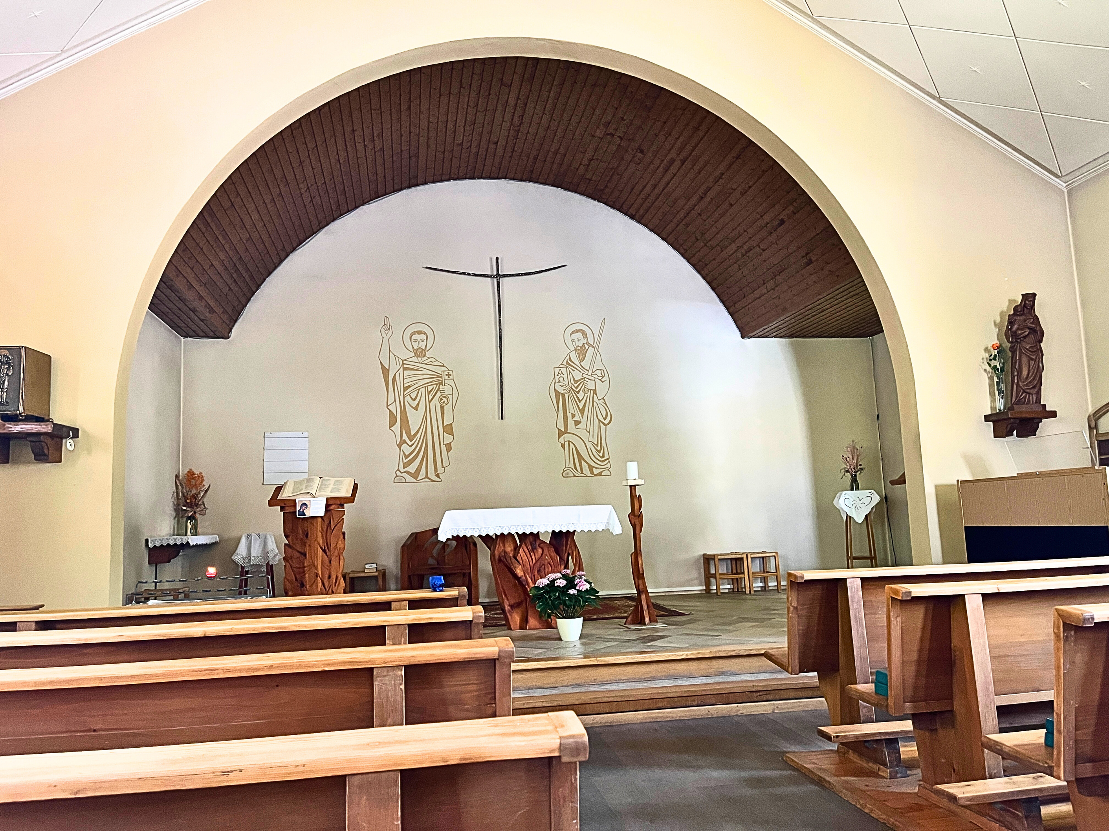

Slide 13
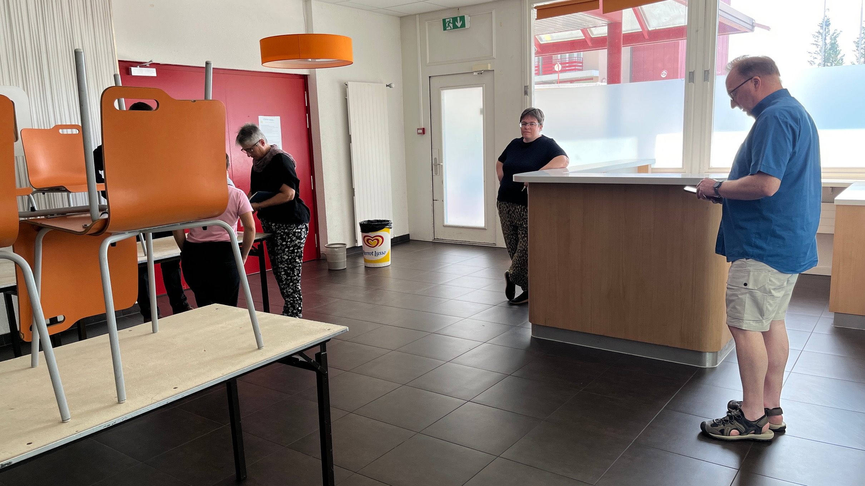

Slide 14
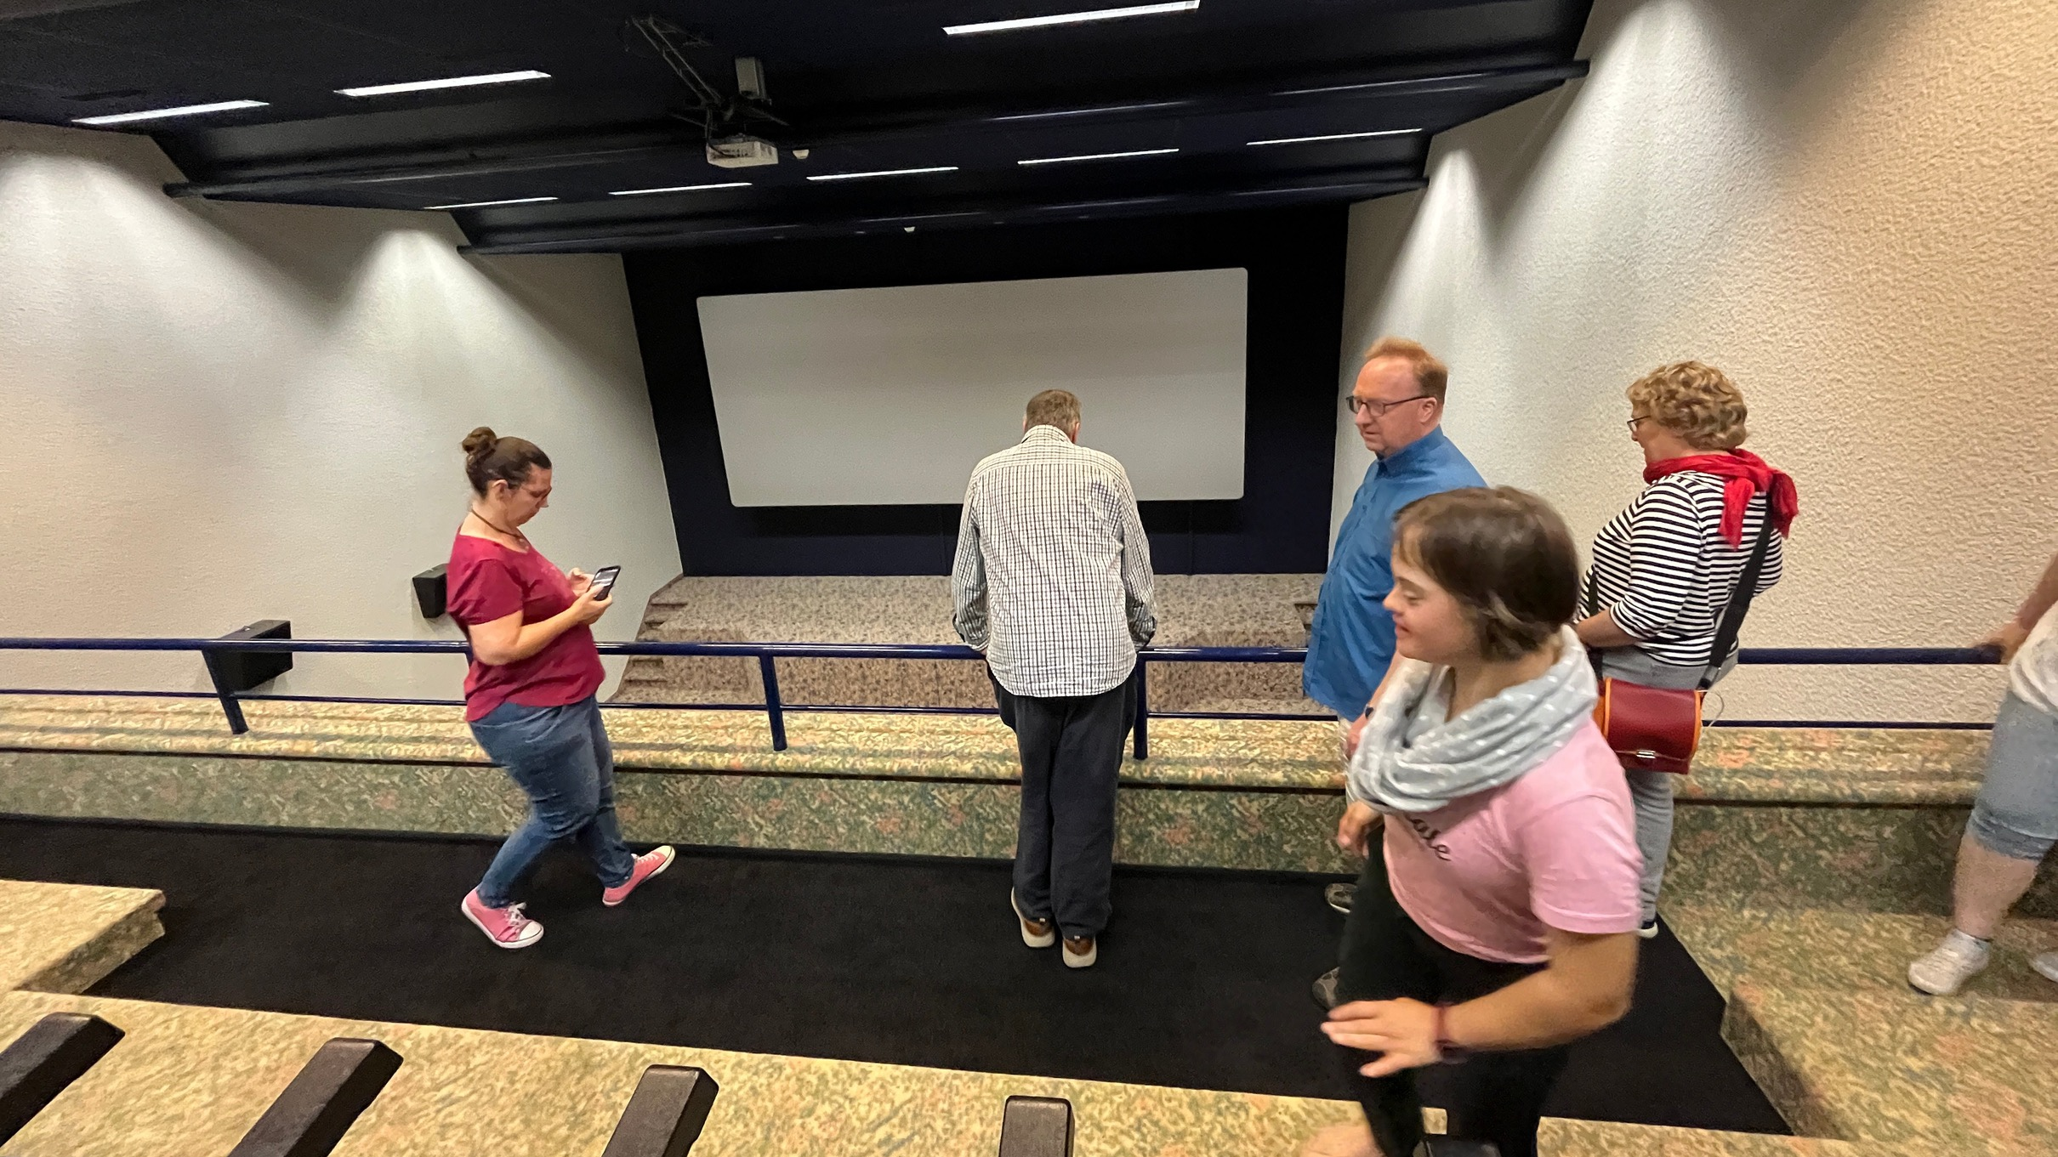

Slide 15
Nordic region: Nordics and Baltics
Regional group for us almost everyday
Wednesday 10 mins: Share current themes, methods, practise
Wednesday: Evening prayer
Workshop on Tuesday of Thirsday, 45 mins about our Nordic Childrens Cathedral network
Invitation to Conference 2029 - Nordics are inviting

